Slide 1
MINI PROJECT
ENHANCED WORD MEMORY GAME IN PYTHON
(GROUP 4)
GROUP MEMBERS
Mohammed Hafiz
Asna
Nimmy
Hima
Aghil
Abil
Archisha

Slide 2
INDEX
1.INTRODUCTION
2.OBJECTIVE
3.FEATURES
4.IMPLEMENTATION
5.USER INTERACTION
6.TESTING AND VALIDATION
7.POTENTIAL IMPROVEMENTS
8.CONCLUSION

Slide 3
1. INTRODUCTION
The Enhanced Memory Test Game is a Pythonbase program designed to improve and evaluate the player's memory skills. The game provides an interactive and engaging way for users to challenge their short-term memory by recalling words from various categories such as fruits, animals, and colors. The game emphasizes user interaction, providing feedback on their performance and encouraging repeated play to enhance memory retention.

Slide 4
2.OBJECTIVE
The main objectives of this project are:
1.To create an interactive memory game that allows players to select different word categories.
2.To challenge player’s memory recall abilities through progressively difficult rounds.
3.To demonstrate the use of Python programming concepts, including conditional statements, loops, and functions.
4.To provide a simple scoring mechanism that encourages players to improve their performance.

Slide 5
3.FEATURES
The project was developed using the Python programming language. The development process involved the following steps:
3.1 Game Design
Category Selection: Players can choose from three word categories—fruits, animals, or colors.
Round-Based Play: The game is divided into multiple rounds, with players deciding the number of rounds they wish to play.
Word Recall: In each round, players are shown a sequence of five random words from the selected category. They have a few seconds to memorize the words before the screen is cleared.
Timed Recall: Players are given 30 seconds to recall and enter as many of the words as they can remember.
Scoring System: After each round, the player’s score is calculated based on the number of correctly recalled words. The total score is accumulated over the rounds.

Slide 6
3.2 Tools and Technologies
Python: The programming language used for implementing the game.
Random Library: Used to randomly select words from the chosen category.
Time Library: Used to control the timing of word display and player input periods.
3.3 Code Implementation
The implementation involves functions that handle different aspects of the game, including word selection, timing, user input, and scoring.

Slide 7
4. Code Explanation

Slide 8
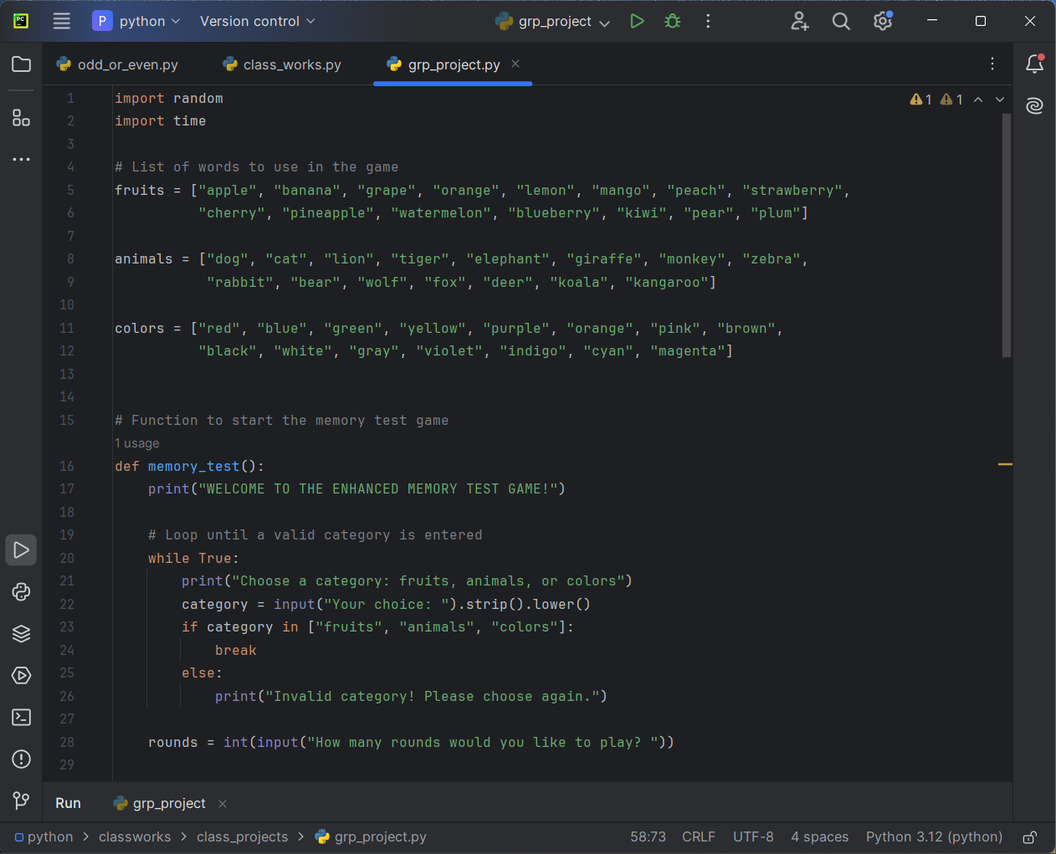

Slide 9
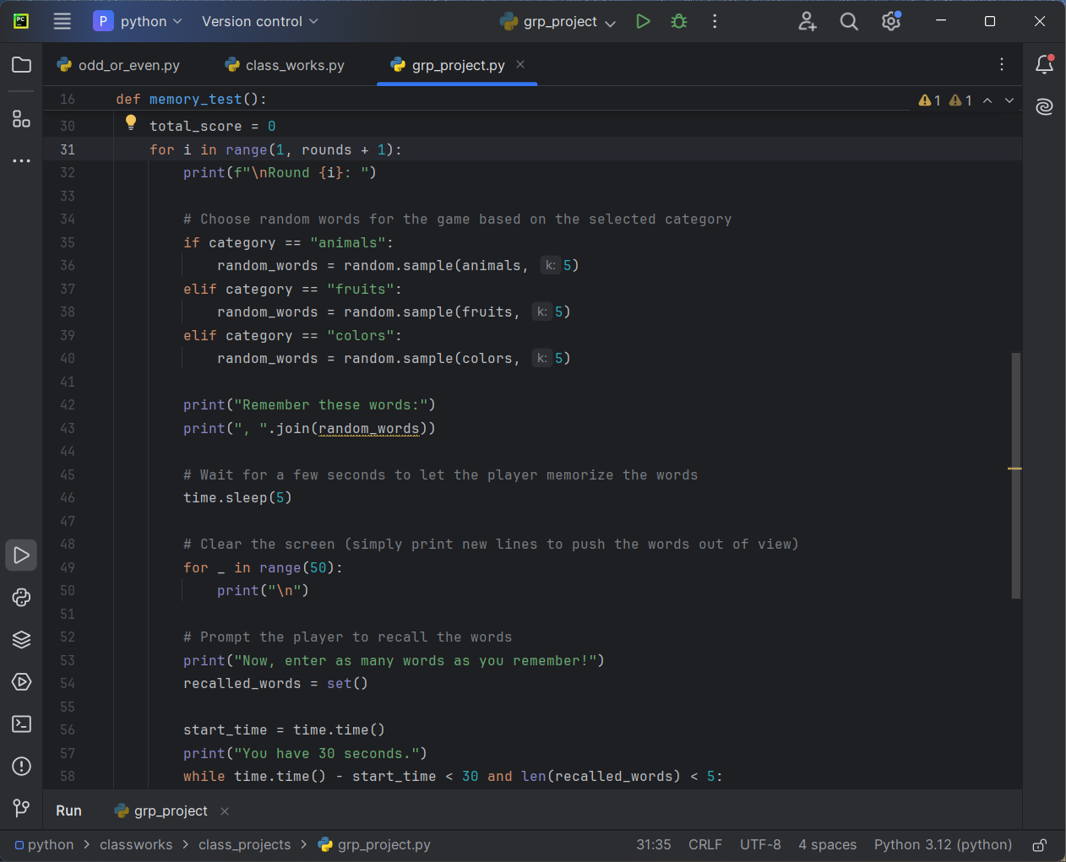

Slide 10
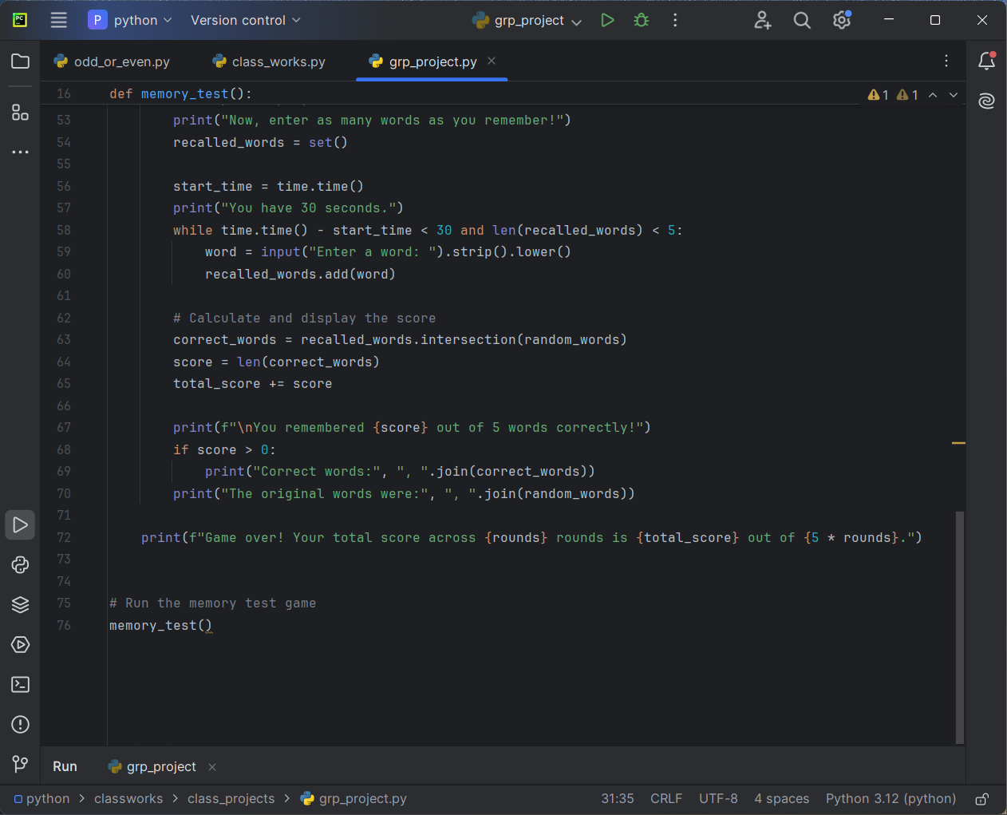

Slide 11
This code sets up a memory test game where players are prompted to
remember words from a chosen category (fruits,animals, or colors).
Here's a breakdown of how the game works:
Game Initialization: The game welcomes the player and prompts
them to choose a category. The player can select either "fruits,“
"animals," or "colors." The player then decides how many rounds
they would like to play.
Rounds: For each round, the game randomly selects five words
from the chosen category. The words are displayed, and the
player is given 5 seconds to memorize them. After 5 seconds, the
screen is cleared to hide the words. The player is then asked to
recall and enter as many of the words as they can within 30
seconds.

Slide 12
Scoring: The game compares the player's recalled words with
the original words. The player earns 1 point for each correct
word. The game displays the number of correct words, the correct
Words themselves, and the original set of words.
Game Over: After all rounds are completed, the game displays
the player's total score.
This game is designed to be a fun and challenging way to test
and improve memory. You can run this code in a Python
Environment to play the game.

Slide 13
OUTPUT

Slide 14
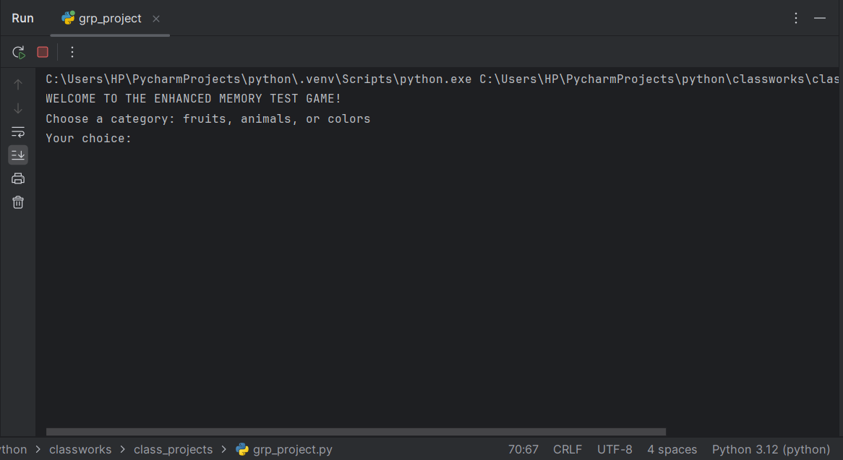

Slide 15
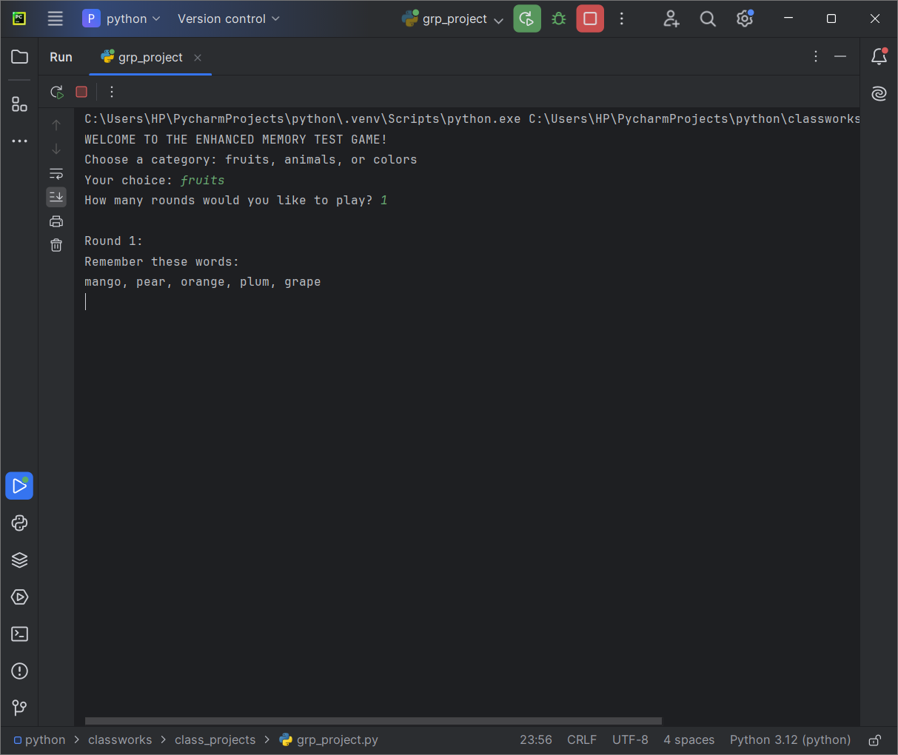

Slide 16
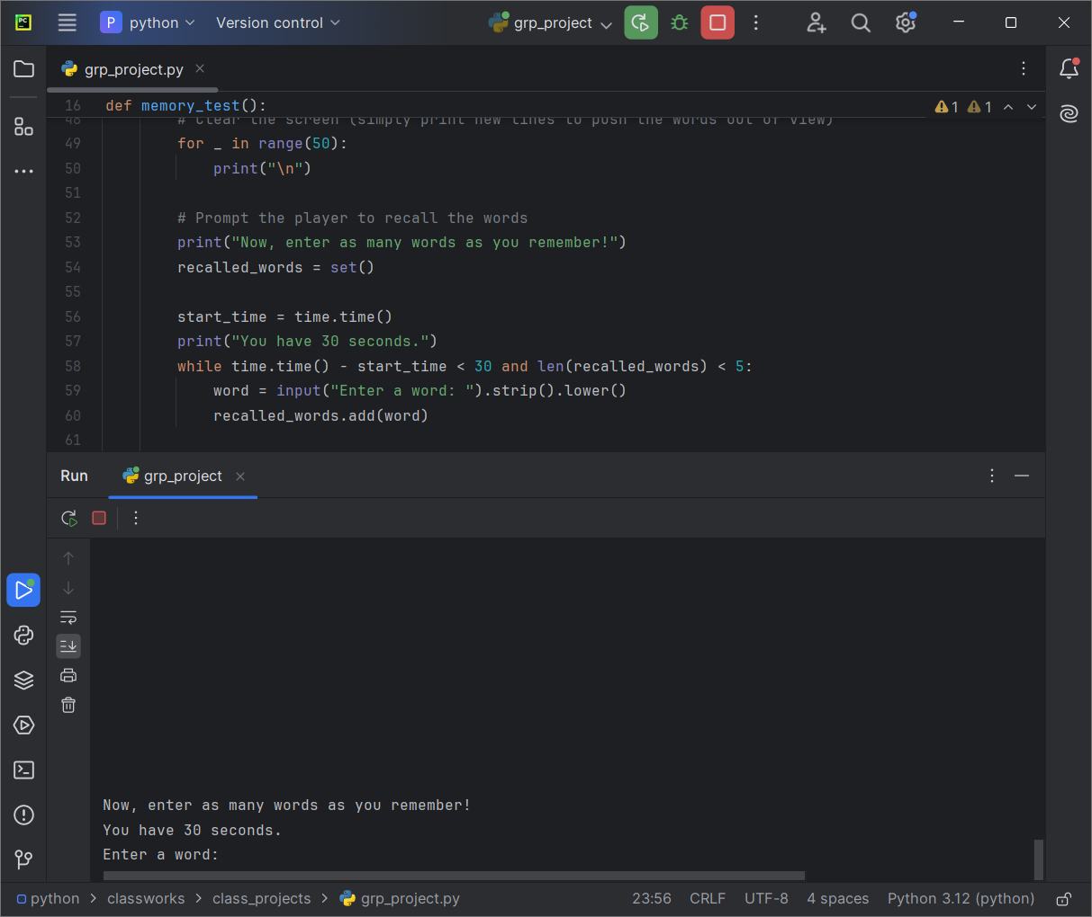

Slide 17
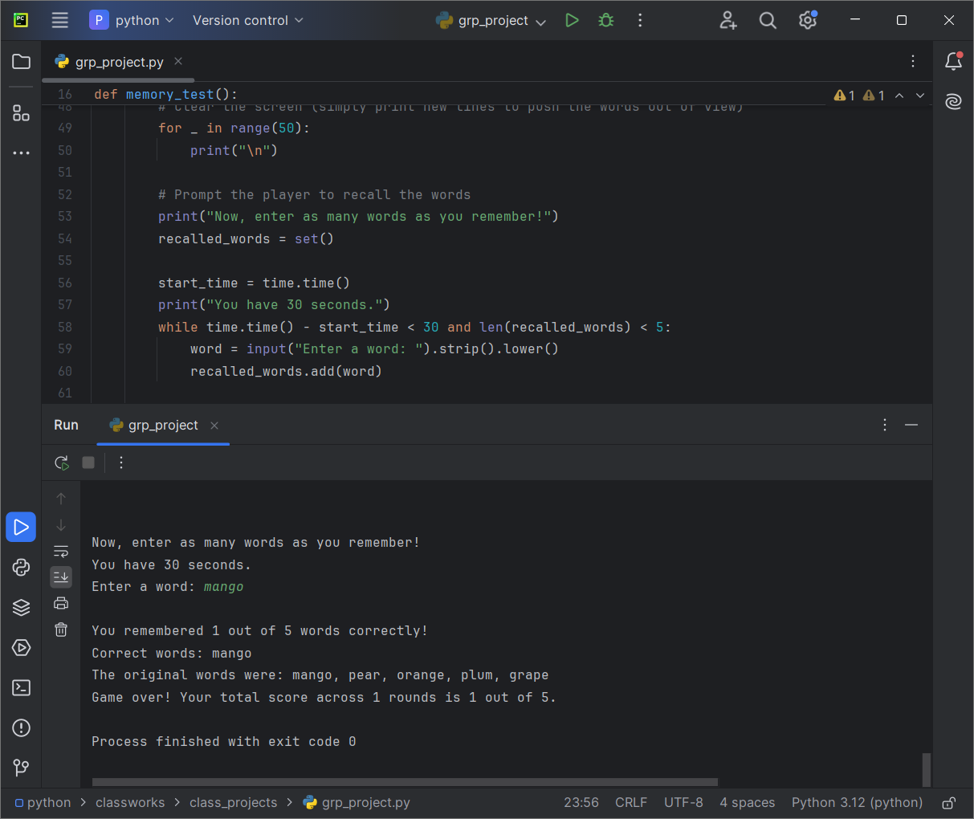

Slide 18
4.IMPLEMENTATION: The game is implemented using Python, leveraging the following key concepts:
DATA STRUCTURES:
Lists: Used to store the categories and words
within each category.
Sets: Used to store the player's recalled words
and calculate the intersection with the correct
words.

Slide 19
CONTROL FLOW:
Loops: Used for repeated prompts and to control the
number of rounds.
Conditional Statements: Used to validate user
input and manage game flow.

Slide 20
TIME MANAGEMENT:
Time.sleep(): Introduces a delay to give the player time to
memorize the words.
Time.time(): Measures the 30-second recall period.
RANDOMIZATION:
Random.sample(): Randomly selects words from the chosen
category, ensuring the game remains challenging.

Slide 21
5. USER INTERACTION
The game is designed with a simple text based interface
that runs in the terminal or command prompt. User
interaction is facilitated through:
Input Prompts: The game continuously interacts
with the player through prompts, guiding them through
the category selection, word memorization, and recall
Process.

Slide 22
Real-Time Feedback: After each round, the game
provides immediate feedback on the player's
performance, enhancing the user experience and
encouraging improvement.

Slide 23
6. TESTING AND VALIDATION
The game was tested under various scenarios to ensure:
Correct Category Handling: The game properly
recognizes and processes each of the three categories.
Randomized Word Selection: Words are randomly
chosen, and repeated plays do not produce predictable
patterns. Accurate Scoring: The game correctly calculates
the score based on the player's input and provides
appropriate feedback. Time Management: The game
accurately times the memorization and recall phases,
ensuring that they conform to the specified durations.

Slide 24
7.POTENTIAL IMPROVEMENTS
While the current implementation meets the project's
objectives, there are several areas for potential
enhancement:
Graphical User Interface (GUI): Implementing a GUI could
make the game more visually appealing and user-friendly.
Difficulty Levels: Introducing varying difficulty levels by
adjusting the number of words, memorization time, and
recall time could cater to a broader range of players.
Leaderboard: Adding a leaderboard feature could increase replay
value by allowing players to compete for high scores.
Integrating sound effects or background music could make the
game more engaging.

Slide 25
8.CONCLUSION
The Enhanced Memory Test Game is a successful
implementation of a simple yet effective tool for
improving and testing short-term memory. By providing
an interactive and enjoyable experience, the game
encourages players to challenge their memory skills and
track their progress over time. This project demonstrates
the effective use of Python programming to create an
educational and entertaining application.

Slide 26
THANK YOU

